Slide 1
Topic 5
Group 0: Erica Chio, Sasha Layne, Peter Stella, Allen Zhu

Slide 2
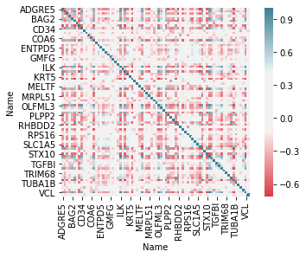
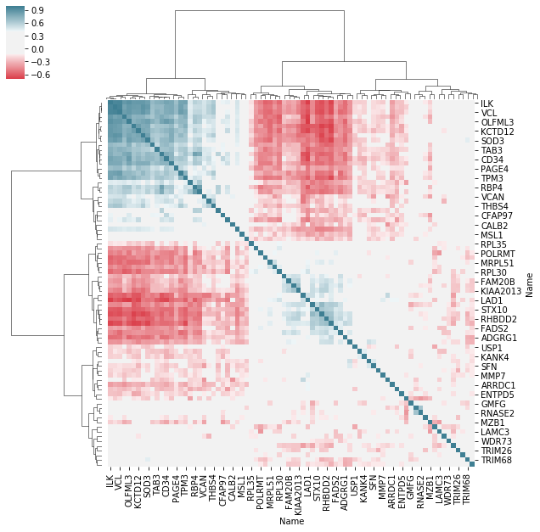
Task 1

Slide 3
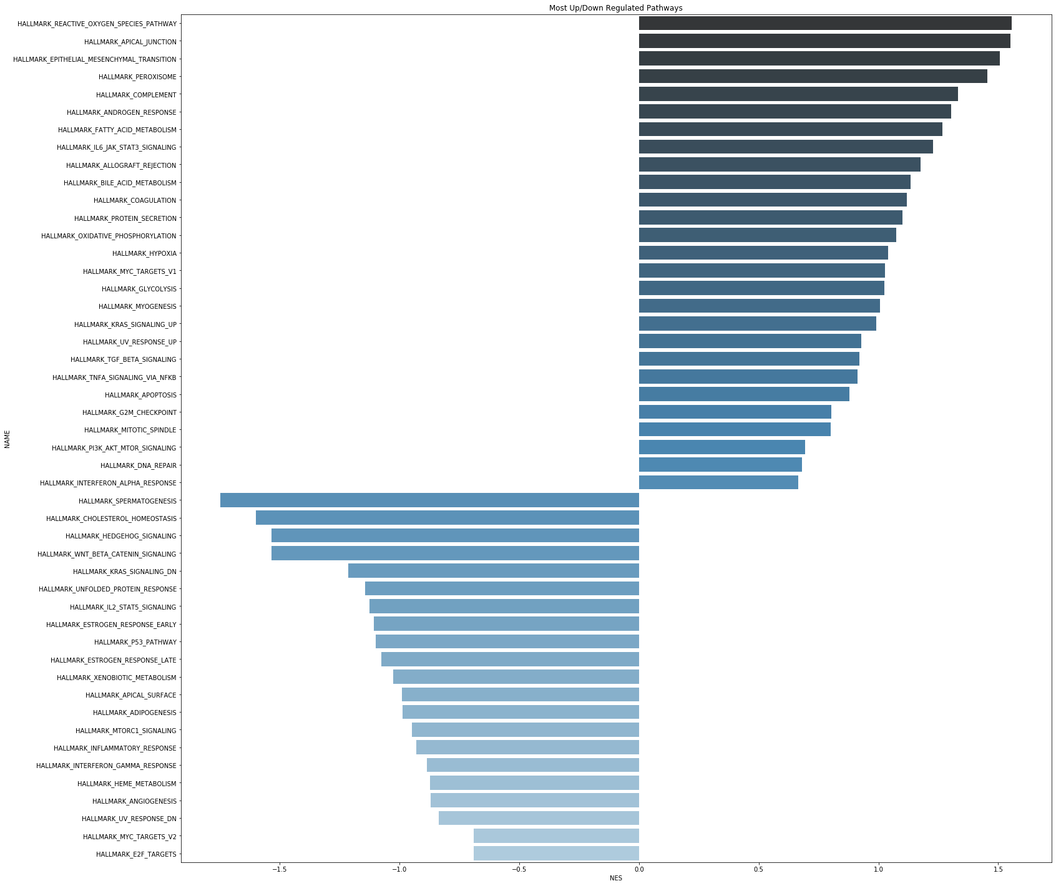
Notes:
Organized by NES score

Slide 4
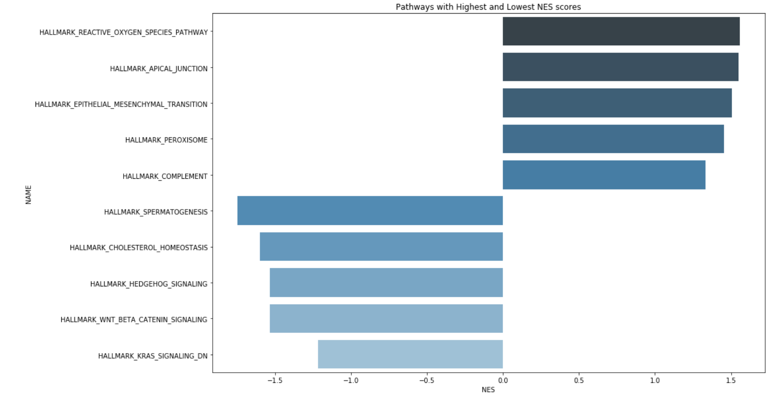
Plotting Only the Top 5 Negative and Positive Enrichment Scores
Notes:
Organized by NES scores

Slide 5
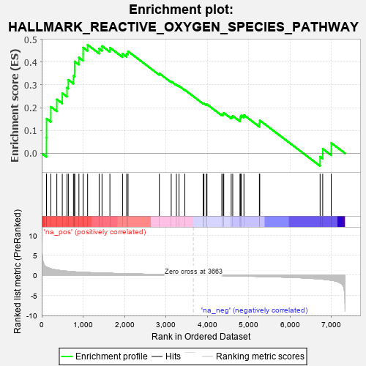
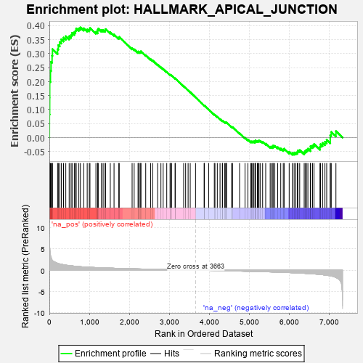
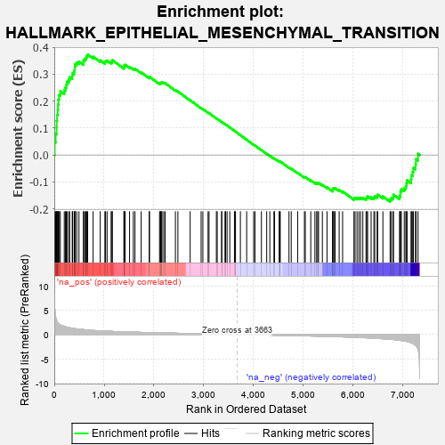
A Look at the Most Upregulated Enrichment Plots
Chronic inflammation could lead to mutations that lead to cancer.
Apical (cellular) junctions affect cell-to-cell junction.
EMT is a hallmark of metastatic cancers where epithelial cells transition into mesenchymal cells.

Slide 6
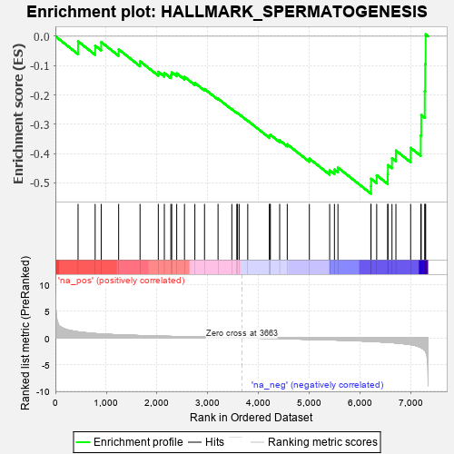
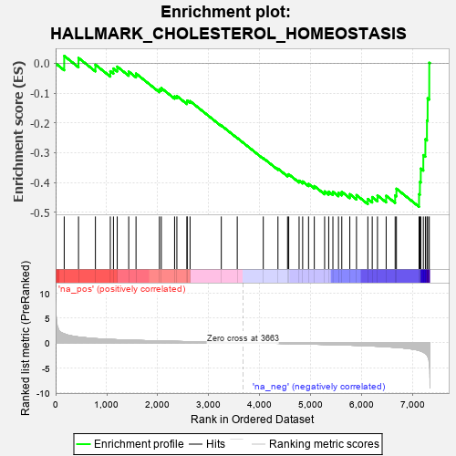
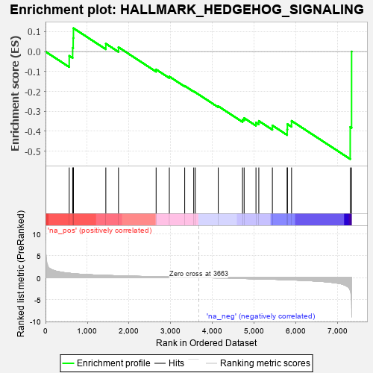
A Look at the Most Down-Regulated Enrichment Plots

Slide 7
